Slide 1
Pentaho Update
Bob Kemper
EVP Engineering, Pentaho

Slide 2
Agenda
Year in review
Pentaho Strategy
Hitachi and Pentaho
Roadmap(s) - abbreviated

Slide 3
Pentaho 2014/2015 - A year of growth
Company awareness - Pentaho widely recognized as leader in Big Data
Number 1 or 2 in most “Share of Voice” metrics
Major new large customer wins
Enterprise deployments and Big Data represent significant percent of business
Continued staff growth in both US and EMEA teams
Across all areas of the business – Sales, marketing, services, support, engineering

Slide 4
Pentaho 2014/2015
Major product releases
Several large product release during the year
5.3 in Q1, 5.4 in Q2
6.0 Platform release in October
And … Acquired by Hitachi Data Systems in May 2015
More on that to come….

Slide 5
Product Releases – 5.3 (February)
CE/EE Features
EE Only Features
Support for CDH 5.2 and MapR 4.0.1
Named Clusters
Carte Clustering
PDI SDK as an “Official” release package
BA Server / Plugin Improvements (Data Access for example - 0 bad builds during ALL 5.3.0 RC builds )
PDI SDK documentation
Carte Clustering documentation
MT Documentation
Over 300 Closed and Validated jiras! (Majority common code)
Using an existing model for publish
Using user-defined annotations to assist auto-model generation
Validated to work with Amazon Redshift and Impala
Vizor as a package
Analyzer JS API and Documentation
PIR Improvements
Analyzer API documentation

Slide 6
Product Releases – 5.4 (June)
CE/EE Features
EE Only Features
New PDI Look and Feel (CE)
BA Server Utilities
C*Tools support for RequireJS
Improved Named Clusters support
AWS EMR Shim Support
Spark Integration
User Console localizations
Mongo 3.0 Support
Google Analytics step upgrades
Analyzer Extensibility APIs
DI Server REST APIs
SAP Hana support in PDI
SDR Modeling improvements

Slide 7
Product Releases – 6.0 (October)
CE/EE Features
EE Only Features
PDI Data Services – Opened and major advances
OSGI Support
New PDI Marketplace
Testing framework for Named Clusters
Library and back end upgrades (Java8, Tomcat8, Drools, VFS, etc, etc.)
REST Apis for User Management
Groundwork for a “Merged BA and DI Server”
Major step improvements/defect resolution in PDI
Lineage capture in PDI (see blogpost by Pedro on displaying through yEd)
Inline Modeling in Analyzer
Annotation improvements in PDI
System monitoring via SNMP
Lineage information through MetaIntegration
Improved import/export
Notes:
Data Services (CE/EE)
Data Services This is huge. Huge. Data Services have been my baby for the past few months and it's going to play a huge part of everything that we'll be doing in the future. It's a very simple concept that Matt Casters came up with a couple years back; but like happens most of the time, takes the rest of the world lots of time to understand what he actually means :p Simply put - we can expose any point of our transformation as a virtual / umaterialized table that can be accessed from the outside through a jdbc interface. And this usage can be not only external but also internal. Some of you may remember that the concept of dataservices appear in 5.0 as the codename jdbc thin driver, an EE only feature. But we huge improvements on the concept, not only at UI level but also on global Caching abilities and Push Down Optimizations. OSGi support (CE/EE)
Warn - tech zone here! Core infrastructure stuff. We included OSGi in the pentaho stack, so now plugins can be built and deployed as OSGi bundles. This will open up possibilities that you don't even dream about... Just as a sneak peak we are now able to have a... New PDI Marketplace (CE/EE)
PDI Marketplace We were able to bring the BA server marketplace into PDI. Nuff said! Named clusters testing framework (CE/EE)
Test named cluster connections Unlike what marketing people try to make you believe, hadoop stuff isn't easy. A lot of things can go wrong. It can be an headache just to do the initial configuration. So we built a set of test cases that will help you troubleshot what happens there, as well as guidelines on how to fix the open issues. And you know what... we did more than that. We built the beginning of a generic and pluggable test framework! You'll be able to plugin your own test cases and you'll also see soon this "test framework" appear in other areas of the product! Library upgrades - Java 8, Tomcat 8, VFS2, etc, etc, etc (CE/EE)
More infrastructure stuff that you may think you don't care about, but you do. It's the stuff that if it wasn't there, you'd complain a lot! A bunch of libraries were upgraded. More than half the stack (I just made this up, but this was huge) to address the latest features, security upgrades, etc. I definitely won't go through it, but I'll just highight Java 8 support as the main headlines Rest APIs for user management (CE/EE)
If you use the Pentaho security, you'll now be able to use, fully supported, rest apis for automating user management Merging BA and DI
I'm listing this here because there were tons of work done here. More on this later. It's amazing stuff, believe me! Import / Export (EE)
Another step into our LifeCycle Management story. The ability to do and automate full system backups and restore! Analyzer Inline modelling / ETL modelling (EE)
Analyzer now has inline modelling capabilities The vision here is clear. The future of modelling is... no well defined modelling stage. And we're giving concrete steps into it. We added the concept of calculated measures into the ETL annotations, keeping on the trend of modelling and matching at the source; And we added some abilities into analyzer so that users can tweak the model, like changing measures aggregations or persisting calculated measures. And we'll be extending that work so that we'll get as far down as redoing levels and dimensions! Tons of improvements into PDI
PDI is one fundamental piece of the stack. We had an entire team dedicated at fixing the top reported issues, improvements... You won't probably even notice at first... but you will definitely know it's there. Monitoring (EE)
We're not reinventing the wheel - We developed into PDI the monitoring hooks so that you can now integrate events into any SNMP system of choice (nagios, I'm looking at you). This is an highly desired future by large governance sensitive organizations! Lineage in PDI (CE/EE)
Lineage information in yEd Keeping on the theme of governance and compliance, organizations not only need to know what etl and transformations they have, they need to know exactly what is happening at any point in time. What files, what parameters, when, by who, etc, etc. So now you can tell pdi to capture that runtime information (core CE capability) as well as consume it through the new MetaIntegration bridge (EE) so that you can visualize it alongside with your broader lineage context

Slide 8
Pentaho Strategy

Slide 9
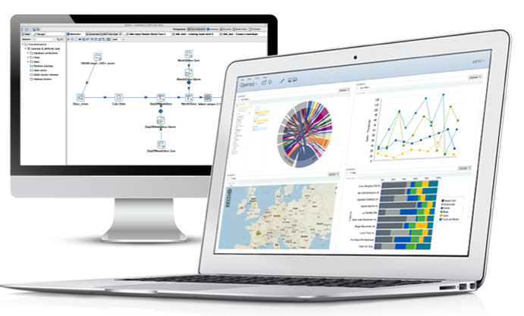
Pentaho enables the Modern Data-driven Business
Modern, Cohesive Business Analytics and Data Integration Platform
Full spectrum of analytics for all key roles
Embeddable, cloud-ready analytics
Broadest and deepest big data integration
Innovation Through an Open Heritage
Open, pluggable, purpose-built for the future
Sustained leadership in big data ecosystem
Business Momentum
Over 1,500 commercial customers
Over 10,000 production deployments
Notes:
Pentaho is an end-to-end business analytics and data integration platform. And in particular, a major area of focus for our platform has been helping customers integrate Big Data sources into their architecture and analyze that blend of traditional and emerging data. At the same time, we also provide analytics software that is highly embeddable in that they can fit seamlessly into existing applications and processes. A lot of our success in these areas has been due to both early innovation in Big Data – I believe we’ve been working with Hadoop for 5 to 6 years – as well as the open architecture and standards that our platform is built on.

Slide 10
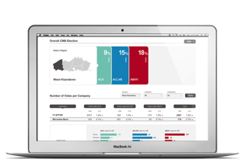
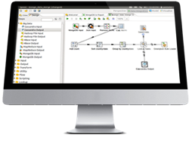
Pentaho is Architected for the Future
Purpose-built to support an evolving data & analytics landscape
Data Integration
Business Analytics
Data Orchestration
Embedded Analytics
Big Data
Data Warehouse
Other
Analyzer
Dashboards
Reporting
Open
Pluggable
100% Java
Notes:
Here’s a closer look at the platform. As you can see, Data Integration includes not just ETL but the ability to orchestrate data flows with higher level logic. And this data can be from Big Data stores like Hadoop or NoSQL databases, data warehouses and relational DBs, or other sources. Meanwhile, these data sources once blended, refined, and modeled are made available to Pentaho Business Analytics, which includes self-service tools for ad hoc analysis and visualization, which fall under our ‘Analyzer’ product, as well as self-service dashboards and reporting.
The platform is built on open standards, like RESTful web based APIs and a 100% java codebase, while at the same time we’ve got frameworks for plugging in new visualizations, data integration steps, and more. As such, the platform is not just ‘end-to-end’ in nature, it also is highly flexible and adaptable – such that it can provide solutions to evolving use cases in a changing data landscape.

Slide 11



Bringing it All Together
Pentaho Bridges Big Data and Traditional Architectures
Network
Existing
Process
or Pentaho
NoSQL
Location
Data Integration
Hadoop Cluster
Analytic DB
Web
Analytics
Social Media
On-Demand Integration & Blending
Data Integration
Customer
Existing
ETL Tool
or Pentaho
Provisioning
Existing ETL Tool or PDI
Data Marts
BI Tools
Billing
EDW
Notes:
So where does Pentaho sit in an enterprise data architecture? Hopefully this diagram helps answer that question. Starting at the lower left, we’ve got some more traditional data sources like customer profiles and billing flowing into an enterprise data warehouse or EDW. Some customers use Pentaho Data Integration for this purpose, and then to model that merged data, routing it downstream to data marts and ultimately to Pentaho Business Analytics. You may have existing tools in place that perform some of these functions.
However, at the top left you may have some more novel data sources, unstructured and semi-structured data from networks, online interactions, social media, sensors, and more. That’s where a lot of customers are using Pentaho to bring that diverse data into Big Data stores like Hadoop or MongoDB. There we provide visual data integration and orchestration, really helping teams to unlock the value of big data faster. From there, we also work with many high performance analytic DBs – and we actually can auto-model and auto-publish data sets for these databases like, Amazon Redshift or HP Vertica – for end user analytics in the Pentaho Business Analytics solution.
And in the middle, finally, you see Pentaho Data Integration linking the traditional EDW and Big Data stores together, also providing for on-demand data integration and blending that can meet just-in-time requests from business users. So in all, we really bring traditional data architecture and big data architecture together to allow you to fully harness all data to grow your business.

Slide 12























End-to-End Self-Service Delivery of Big Data Analytics
Systems
Admin
Data
Modeler
Business
Users
Any Data
Data Refinery
Any Analytics
Analytics
Embedded
Other
BI Tools

Slide 13
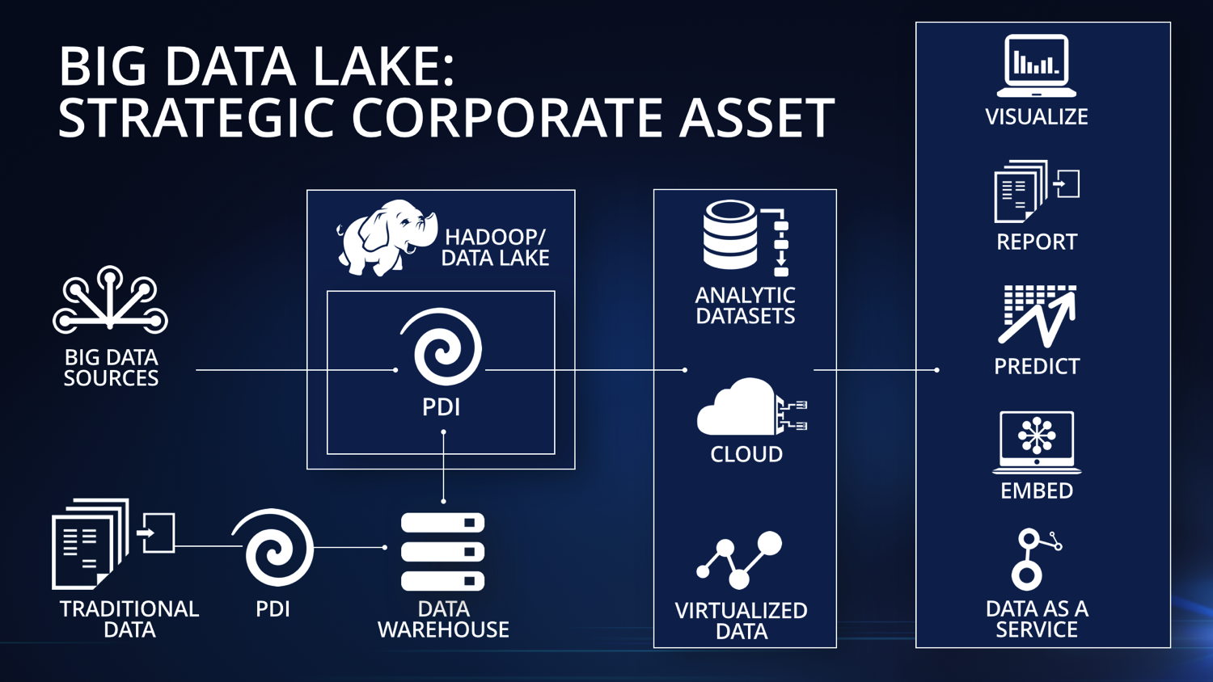

Slide 14
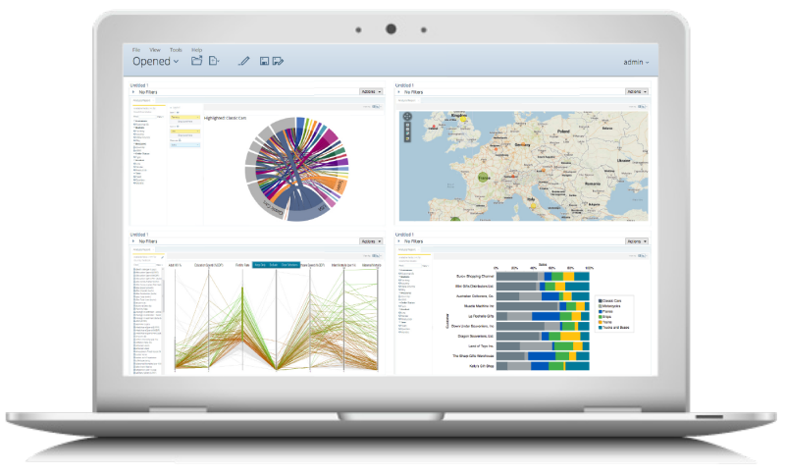

Why Did Hitachi Acquire Pentaho?
Leader in the big data & business analytics market

Slide 15
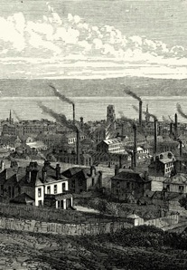




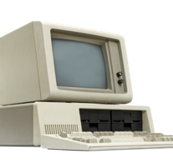
The Next Revolution
INDUSTRIAL
DIGITAL
INTERNET
INTERNET OF THINGS
Notes:
And solving big problems
Making things that made work and life better
Standards of living
Economic growth
Problems we never thought we could solve
In ways we never thought possible
IoT revolution bigger
Economic impact
People’s safety and well-being
Address our biggest issues
Life better…for all of us

Slide 16




Internet of Things in 2020
152M connected cars (IHS Automotive)
1.1B smart meters installed (Navigant Research)
200B connected objects (Intel)
$19T economic value created by Internet of
Things (Cisco)
$2.5T annual impact of IoT in healthcare (by 2025, McKinsey)
>90% IoT data to be hosted on cloud platforms (IDC)
Notes:
These are just a few data points showing the scale of “things”
The impact that IoT will have
And the importance of cloud platforms in addressing IoT needs

Slide 17

The Opportunity in 2020
Internet of Things
Social Innovation
$7.1 trillion
$2 trillion
Notes:
The total market size for IoT is predicted to be over $7 trillion by 2020
And, given the industries that we play in and the products and solutions that we build, we estimate our addressable market to be $2 trillion
As a commercial enterprise, that market opportunity certainly gets our attention
But more importantly, we see this as a measure of the enormous impact that we can make by investing in our IoT business and bringing real solutions to market that make a difference
We feel that this is more than an opportunity; it’s an obligation that we have

Slide 18

Our IoT Strategy
Integrating IT and Infrastructure Technologies for a Safer, Smarter, Healthier World
HITACHI’S SOCIAL INNOVATION BUSINESS
The Internet of Things That Matter
Notes:
This where are Social Innovation Strategy comes into play
It’s our strategy for IoT that leverages our IT capabilities with our Industrial or Infrastructure capabilities to address big problems
And it’s focused on what we call the Internet of Things that Matter
We don’t dismiss the importance of IoT devices that we’re seeing in the consumer markets
We’re focused those areas where we can help drive better healthcare outcomes for large populations
And making energy more reliable and efficient for cities and states
And making transportation safer and more reliable
That’s what we mean by IoT that matter

Slide 19

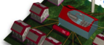

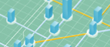


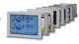




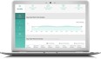



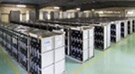


The Internet of Things That Matter
ENERGY
HEALTHCARE
MICROGRIDS &
GRID STABILITY
WIND TURBINES
INFORMATION & CONTROL SYSTEMS
CLINICAL DATA MANAGEMENT
NURSING CARE SOLUTIONS
PARTICLE BEAM THERAPY
ENERGY SAVINGS AS A SERVICE
SOLAR POWER
NUCLEAR POWER PLANTS
PRECISION MEDICINE
PHARMACEUTICAL SOLUTIONS
BIOINFORMATICS
BATTERY SYSTEMS
TESTING AND DIAGNOSTIC SYSTEMS
MEDICAL IMAGING AND DISTRIBUTION SYSTEMS
Notes:
Energy
For decades, Hitachi is delivering a wide array of turn-key complex energy systems globally, including traditional bulk power plants from thermal, nuclear, wind, hydro and solar sources.
Hitachi delivers the IT/OT control systems needed to run these critical central generation systems effectively.
Importantly, Hitachi also recognizes that customer requirements and technology changes are helping to lead the energy industry through a significant era of evolution that will require new engineering, design, financing, supporting, operation and maintenance models.
This shift will include bringing more renewable energy sources online, utilizing efficiently battery storage systems for renewable energy frequency & Voltage regulation, as well as peak shaving/demand shifting, using distributed energy resources for increased resiliency and savings through implementation of Microgrids.
Also, new IoT-based IT technologies and real-time analytics will be needed to manage, optimize and coordinate this distributed generation grid with the primary grid, for example, using Hitachi state of the art Area Energy Management System (AEMS).
This shift in the energy industry will follow patterns we have seen over the last couple of decades in the Telecommunications and IT Hardware businesses…with those central models giving way to more flexibility, capability and power moving closer to distributed end customers.
Healthcare
Hitachi is a recognized innovator, global leader and trusted partner that healthcare systems turn to for expertise, help and encouragement as they continue to change healthcare profoundly for the better. Hitachi designs, develops and delivers medical imaging and information technologies, medical diagnostics, patient monitoring systems, performance improvement and performance solutions services that help our customers deliver better care to more people around the world, at a lower cost, with better outcomes.
Technological advancements are transforming the entire healthcare industry.
The proliferation of new technology in healthcare is exploding.
Wearable Tracking Devices
70 million people in the U.S. are using wearable tracking devices to monitor their physical activity, sleep patterns, calorie consumption and a whole lot more. This is an exciting new frontier with so much potential to improve patient care. It will be fun to see the impact this trend has on improved patient engagement.
Patient-Centered Care
A significant change in the healthcare industry’s approach to providing care is underway—putting the patient at the center of care. The goal is to improve patient satisfaction scores and engagement. But, this is new territory, and the industry as a whole is just starting to look into ways to engage with patients outside of a traditional office visit. For example, many providers haven’t yet tapped social media to build relationships with their customers. This will need to change, especially as patients begin to shop for healthcare the way they shop for cars or electrician services—by searching the Internet, looking for quality metrics and patient reviews, and comparing prices.
Increased Data Demands
Both clinicians and administrative leaders are hungry for data to make decisions and guide their planning. Yet, there always seems to be a missing piece of information, such as which skilled nursing facility a patient was discharged to. For this example, providers either have to make assumptions based on unreliable data or try to get that data through cumbersome processes.

Slide 20



Hitachi Social Innovation Investment
Platform AND technology
People AND experience
Pentaho
Common analytics framework
Converged Platforms
Content Platform
$1B IoT and big data R&D
500+ data scientists and researchers worldwide
600+ employees in the
Social Innovation Business Unit
75+ resources in Hitachi Live Insight Center of Excellence
HITACHI PATENTS
A leader in data analytics technology patents
2800+ pending
Notes:
With more than 2800 patent applications
Hitachi is #1 in pending patents for Big Data analytics technologies
That’s nearly 2x as many as IBM
And 2x as many as Oracle and Microsoft combined
20% of Hitachi’s R&D/ spend goes to IoT/Big Data spend = over $1B
And 500 researchers worldwide
Over 600 people in my group
Who collaborate with Hitachi colleagues around the world and ecosystem partners to bring solutions to market
Hitachi Live Insight Center of Excellence
More than 75 employees
To help customers swiftly test, customize, deploy and operationalize advanced data analytics solutions, applications and platforms to support new business initiatives.
The Center of Excellence leverages capabilities from multiple areas, bringing together business process expertise from Hitachi Consulting, IT implementation expertise from HDS, and data science from our Big Data Labs.

Slide 21

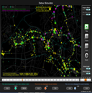
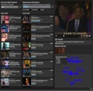
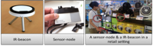
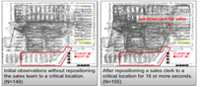
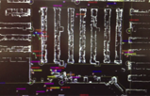
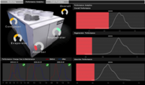

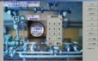

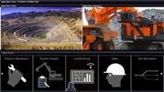
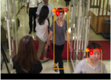
Hitachi R&D
Human Behavior Analysis
2100+ Labs Researchers Worldwide
Traffic Analysis
Image Search
Power Grid Optimization
Robotics
People Flow Analysis
Oil Field Analysis
Augmented Reality
Object Recognition
Mining Optimization
Facial Recognition
Notes:
In addition to the CSI groups, Hitachi has several labs focused on R&D:
The Center for Technology Innovation is comprised of nine centers. It strengthens technology platforms, fuses various technologies and promotes R&D for innovative products, all of which are needed in the solutions developed by the Centers for Social Innovation.
The Center for Exploratory Research targets cutting-edge technologies from a long-term perspective, and strives to create technology platforms for the future.
Together, the CSIs and Labs have more than 2600 researchers worldwide, including 600+ PhDs in Japan alone.

Slide 22





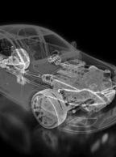
Delivering Real IoT Solutions
SMART CITY
TELECOM
HEALTHCARE
I.T. ANALYTICS
ENERGY
INTELLIGENT VEHICLE
PENTAHO
IoT ANALYTICS PLATFORM
Notes:
So for those industries where the SIBU is focused, we have PURPOSE-BUILT SOLUTIONS
Smart City: Public Safety and City Data Exchange, which I’ll share more details on in a moment
Telecom – Live Insight for Telco
Healthcare - HCR
IT Analytics – Live Insight for IT Operations
Energy – Microgrid
And we’re in the development stage on a couple of Intelligent Vehicle solutions – stay tuned on that
And there are two FOUNDATIONAL ELEMENTS of everything we’re developing
PENTAHO, which I’ll touch on in the next slide
And a PLATFORM for IoT Analytics

Slide 23
Pentaho Roadmap
(snapshot)

Slide 24
Safe Harbor Statement
The forward-looking statements contained in this document represent an outline of our current intended product direction. It is provided for information purposes only and is not a commitment to deliver any new or enhanced product or functionality, or that we will pursue the product direction described. Facts and circumstances may occur which may impact current plans, resulting in changes to the information in this presentation. This information is current only as of the date it is made and should not be relied upon in making purchasing decisions. The development, release (if at all), and timing of any features or functionality described for the Pentaho products remains at the sole discretion of Pentaho.

Slide 25
Point of View: Pentaho Data Integration
The challenge:
More users have access and need access to data blending
Security, governance and audit are recognized as critical for ALL Data
Data from the lake needs to be blended with the EDW and external sources
You can’t always know what the data will look like until it arrives
The direction:
Continue work on security & governance integration
Improve ease of use and performance of data blending
Bring data blending closer to the user
Extend existing capabilities for dynamic blending

Slide 26
Roadmap
Continue security, governance & operations management
Kerberos support
Lineage
SNMP monitoring
OPS Mart improvements
2015
Flexibility in delegation of authority and action via Kerberos
Focus on audit, logging, debugging, resource management
2016
Interoperability with security & governance providers
Futures
Notes:
Focus on security & governance integration

Slide 27
Roadmap
Improve Ease of Use and Performance of Data Blending
Sqoop step updates
Spark executor step
ElasticSearch updates
2015
JSON and HBASE step updates for MapReduce
Investigating broader support for emerging SQL on Hadoop technologies – Presto, Phoenix, Spark-SQL…
2016
Constant investigation into opportunities for performance and scaling
Continue labs investigation of emerging Big Data technologies and productize as appropriate
Futures
Notes:
Improve ease of use and performance of data blending
Bring data blending closer to the user
Extend existing capabilities for data and parameter driven transformations
Investigations into IOT device and machine log formats

Slide 28
Roadmap
Bring Powerful Big Data Blending Closer to the Analyst
Annotations stream step
Auto-model build step
Data Services
2015
Easy to create prompts for dynamic transformations
Investigations into faceted search workflows
Best practices and samples for SDR use cases
2016
Investigation into web-based interface for blending & analytics together
Futures

Slide 29
Roadmap
Extend existing capabilities for dynamic & model driven transformations
Dynamic Blending (Metadata injection) exists and supports a variety of IOT, dynamic and model driven uses cases
2015
Extend support & documentation of metadata injection
Investigate IOT device and machine log formats to add
2016
Continue documentation and best practices for dynamic transformation with metadata injection
Investigate input steps to add in support of IOT use case
Futures
Notes:
Extend existing capabilities for data and parameter driven transformations
Investigations into IOT device and machine log formats

Slide 30
Point of View: Pentaho Platform
The Challenge:
Deployment automation & configuration management are increasingly popular – but there are many technologies at play
Security, governance and audit are increasing concerns
Use of analytics is exploding & increasing demand for easier application maintenance
The Direction:
Improve deployment, configuration & upgrade
Continue expanding capabilities for governance & operational management
Standardize & simplify common role based administration tasks from a central location

Slide 31
Roadmap
Improve deployment, configuration & upgrade
Simplification of configuration with Hadoop & Data Services
2015
Platform deployment, configuration & upgrades on local & remote servers
Lifecycle management/versioning
2016
Investigating tenant administration & configuration
Futures

Slide 32
Roadmap
Continue expanding capabilities for governance & operational management
SNMP Monitoring
Data Lineage in PDI
OPS Mart improvements
2015
Investigating next steps on lineage
Focus on audit, logging, debugging, resource management
2016
Investigating specific industry regulatory requirements
Futures

Slide 33
Roadmap
Standardize & simplify common role based administration tasks from a central location
REST APIs for automated user management
2015
Phase 1: Standardize & simplify common role-based administration tasks
Investigate scheduling interoperability improvements
2016
Phase 2: Centralize administration & management
Investigating improvements to tenant administration & management
Futures

Slide 34
Point of View : Embedded Analytics
The Challenge:
The expectation of agile, tailored experiences is increasing
Security, governance and audit are increasing concerns
Data from the lake needs to be blended with the warehouse and other external sources
The Direction:
Continue to expand and harden Analyzer APIs
Invest in built-in capabilities
Bring Big Data Blending closer to the user
Extend and harden the Pentaho Platform Infrastructure

Slide 35
Roadmap
Expanding and hardening APIs
REST API for User Management
2015
Visualization APIs
Geo-mapping APIs
2016
Investigating componentization for lighter web embedding
Futures

Slide 36
Roadmap
Built-in Functionality
Inline modeling v1
2015
Updates to visualizations
Inline modeling for user defined groups and hierarchies
Export formatting
2016
Investigating technologies for higher performance analytics
Futures

Slide 37
Roadmap
Bring powerful big data blending closer to the analyst
Annotations stream step
Auto-model build step
Data Services
2015
Easy to create prompts for dynamic transformations
Investigations into faceted search workflows
2016
Investigation into web-based interface for blending & analytics together
Futures

Slide 38
Roadmap
Extend and harden the Pentaho Platform Infrastructure
Spring 4 enables SSO and Third Party Authentication
Java, Tomcat and JCR updates for security & performance
2015
Lineage available to enterprise metadata management tools
Phase 1: simplified administration & management
2016
Investigating improvements to tenant administration & management
Futures

Slide 39
C*Tools and overall Roadmap
Will be provided by Pedro –
STAY TUNED!

Slide 40
General Community roadmap additions
Near term - Open the Annotations and Model build/publish steps
New processes for community contributions
See Marc Batchelor’s session later today
High level agreement to open PIR
Discussions with Hitachi and HDS about opening some of their tech
Candidates – streaming engine, search and content indexing, IoT platform components, etc.

Slide 41
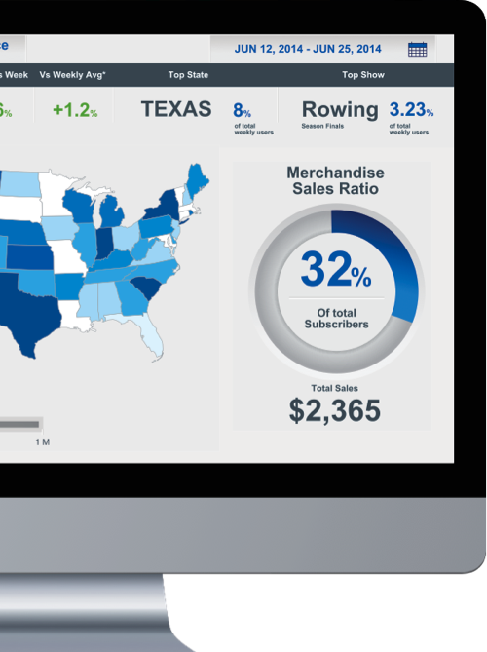
Pentaho Commitment
A future-proof data foundation
Innovation in the big data ecosystem
Enterprise class platform
Become MORE open – with full Hitachi support
Embrace our roots of Open Source

Slide 42


